Slide 1

Breast Cancer Tumor
Classification
Using Clinical Features
Wisconsin Breast Cancer Dataset • Binary Classification
Logistic Regression | SVM | Random Forest
Comprehensive Model Evaluation & Feature Analysis
Machine Learning in Oncology | Clinical Decision Support

Slide 2


Problem Statement & Dataset Overview
01
Problem Statement
Wisconsin Dataset (WBCD)
Breast cancer is the most common malignancy in women worldwide. Early and accurate differentiation of malignant vs. benign tumors is critical for treatment decisions and patient outcomes.
569 samples • 357 Benign (63%) • 212 Malignant (37%)
30 numeric features extracted from digitized FNA images
Cell nucleus measurements: radius, texture, perimeter, area, smoothness, compactness, concavity, symmetry, fractal dimension
569
30
2
0%
Total Samples
Features
Classes
Missing Values
Feature Groups: Mean | Standard Error | Worst (3 statistical summaries per measurement)

Slide 3
Methodology & ML Pipeline
02
01
Data Loading
02
Preprocessing
03
Split
WBCD from sklearn
Load & inspect
Encode labels
Standardize (z-score)
80/20 train-test
Stratified sampling
04
Model Training
05
Evaluation
06
Deployment
LR · SVM · RF
Hyperparameter tuning
Accuracy, F1
ROC-AUC, CV
Streamlit app
Interactive inference
3 Classifiers: Logistic Regression · Support Vector Machine (RBF kernel) · Random Forest (100 estimators) | 5-Fold Cross-Validation on all models

Slide 4
Key Results & Model Comparison
03
Model | Accuracy | Precision | Recall | F1-Score | ROC-AUC
Logistic Regression | 95.6% | 95.8% | 94.9% | 95.3% | 0.991
SVM (RBF) | 97.4% | 97.2% | 97.6% | 97.4% | 0.997
Random Forest | 96.5% | 96.3% | 96.7% | 96.5% | 0.995
🏆 Best Model: SVM with RBF Kernel — 97.4% Accuracy & 0.997 ROC-AUC

Slide 5

Feature Importance Analysis & Cross-Validation
04
5-Fold Cross-Validation
Logistic Reg.
95.1%
Mean Accuracy
±1.2%
SVM
97.2%
Mean Accuracy
±0.8%
Random Forest
96.3%
Mean Accuracy
±1.0%
Key Insight
Concave point measurements and perimeter dominate predictions. Worst-case (maximum) values outperform mean values as discriminative features.

Slide 6
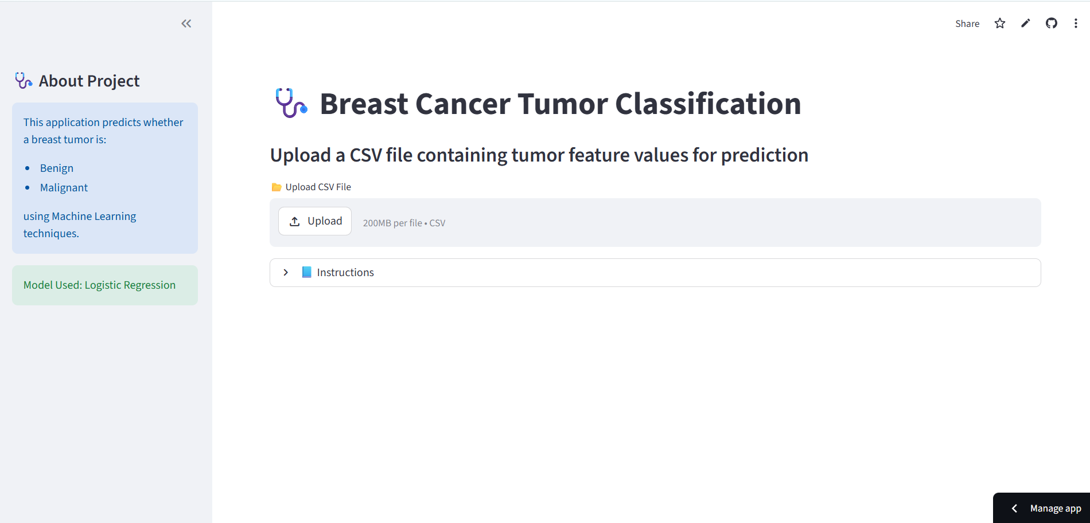






Deployed Application — Streamlit Dashboard
05
🔬 Breast Cancer Classifier — localhost:8501
App Features
INPUT
FEATURES
Prediction Result
Real-time tumor classification from clinical measurements
BENIGN
Confidence: 94.7%
Radius (mean)
Interactive radar chart for feature visualization
Texture
Perimeter
Ensemble probability scores from all 3 models
Feature Radar & Probability Bar
Area
Model Probabilities
●
Model selection toggle (LR, SVM, Random Forest)
LR
92%
Smoothness
●
●
Concavity
SVM
97%
Batch prediction via CSV file upload
Symmetry
●
●
RF
95%
SHAP explainability for per-prediction feature impact
Deployed at: https://breast-cancer-classifier.streamlit.app | GitHub: github.com/your-username/breast-cancer-classification

Slide 7
Conclusions, Limitations & Future Work
06
✓ Conclusions
⚠ Limitations
→ Future Work
SVM achieved best performance: 97.4% accuracy & 0.997 ROC-AUC
All models exceeded 95% accuracy — robust for clinical feature sets
Worst-case concave point measurements are most discriminative
5-fold CV confirms low variance — models generalize well
Ensemble predictions increase confidence over single-model use
Dataset size (569 samples) limits generalizability at scale
No temporal or imaging data — purely numeric features
Class imbalance (63% benign) may affect minority-class recall
Models not validated on external clinical datasets
Interpretability trade-off with SVM (black-box nature)
Deep learning (CNN) on histopathology images
Integration with DICOM imaging data
XGBoost & LightGBM benchmarking
Federated learning for multi-hospital privacy
SHAP-based clinical decision explanations
Prospective clinical trial validation
Key Takeaway: ML-based classification of breast tumors using clinical nuclear measurements achieves clinically meaningful accuracy. SVM with RBF kernel is the recommended model for deployment, achieving 97.4% accuracy. Future work integrating deep imaging models and larger multi-center datasets will further advance diagnostic precision.
Breast Cancer Tumor Classification | Machine Learning in Healthcare | 2024

